Slide 1
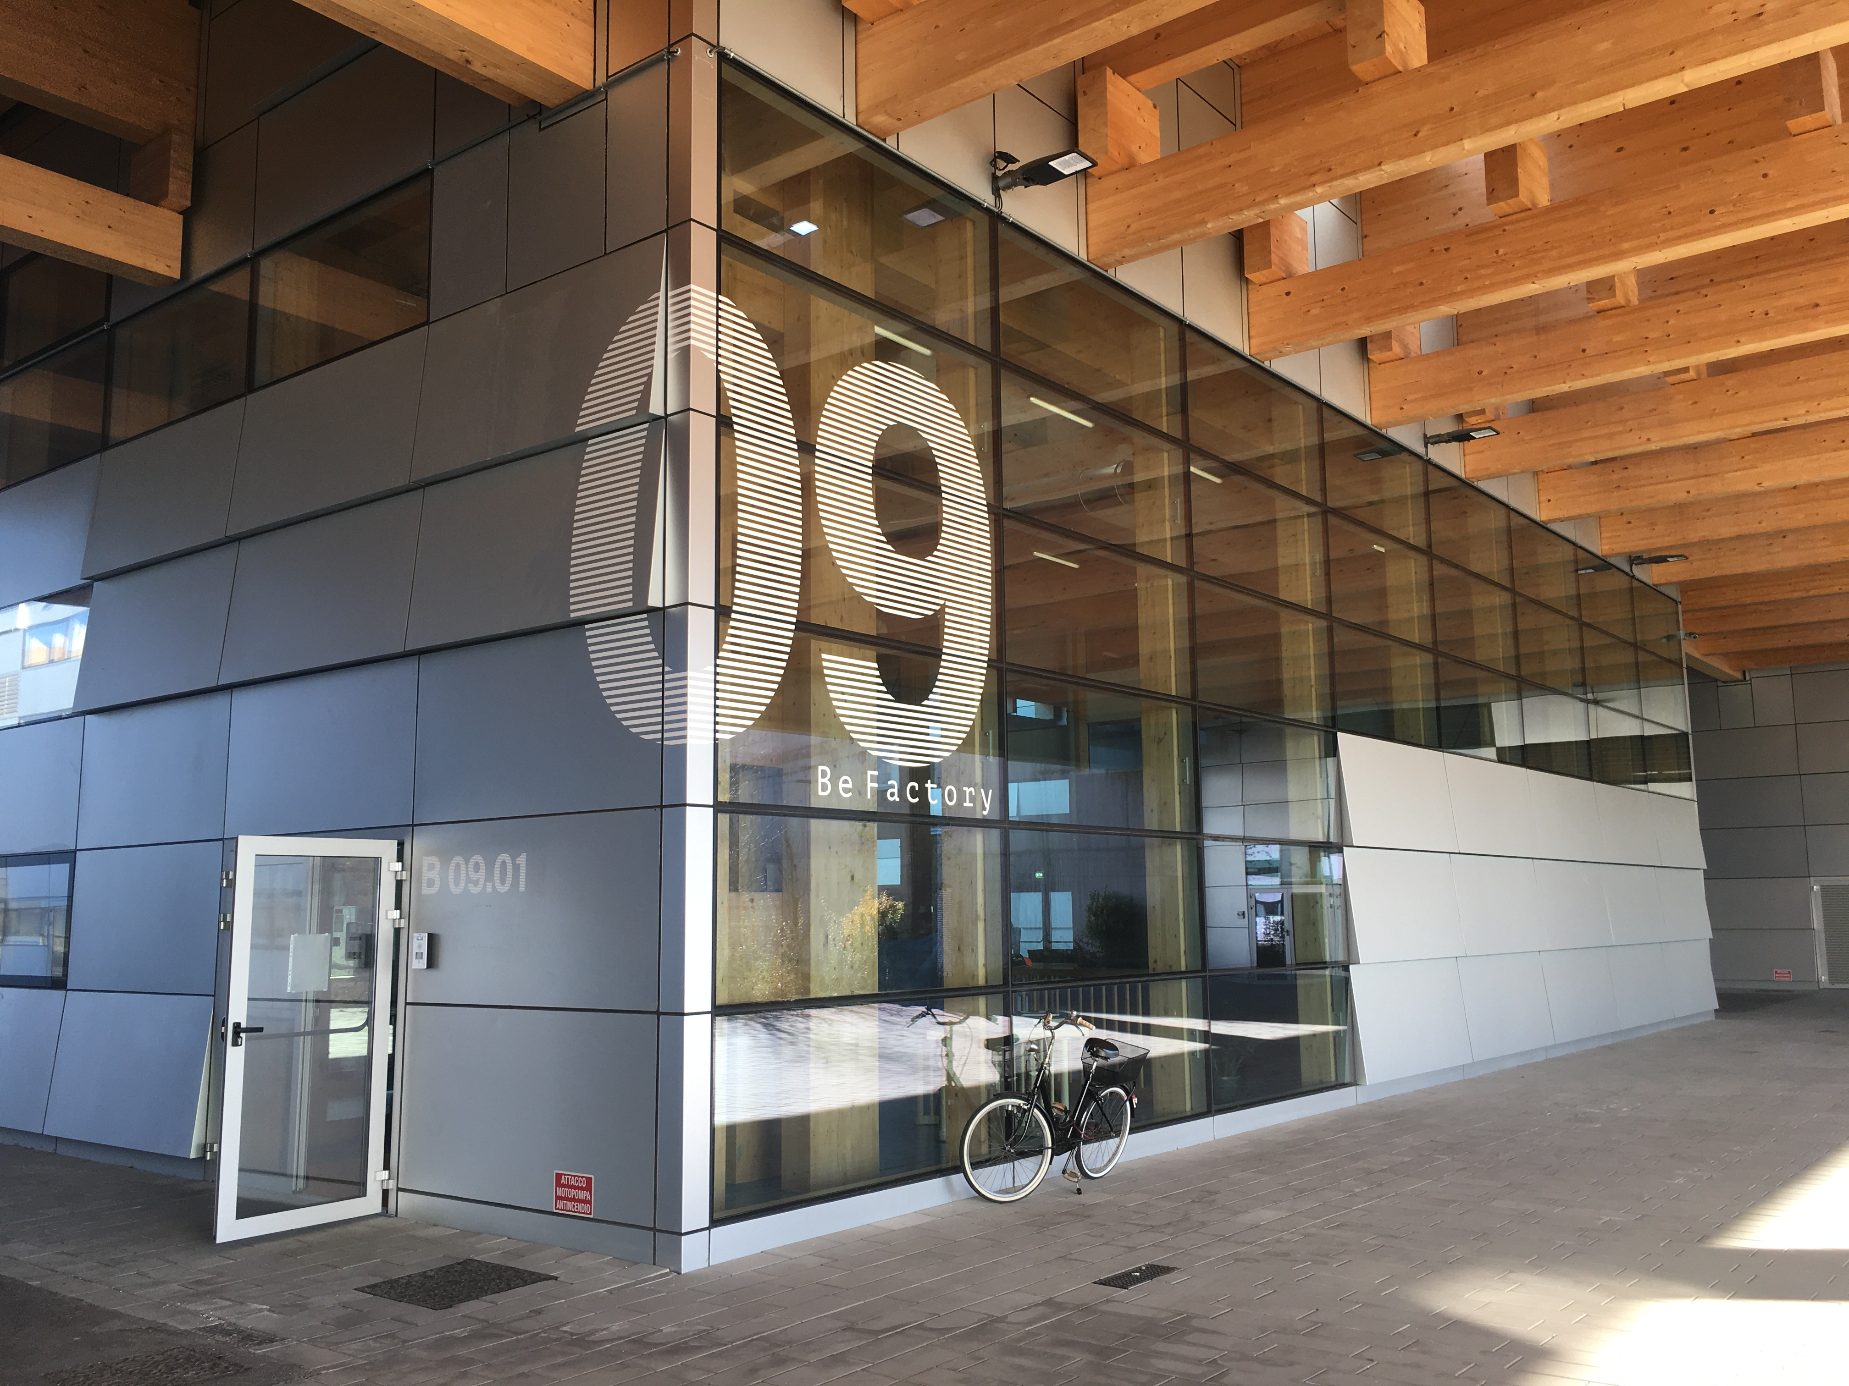

Pursue of quality
Media System Lab

Slide 2
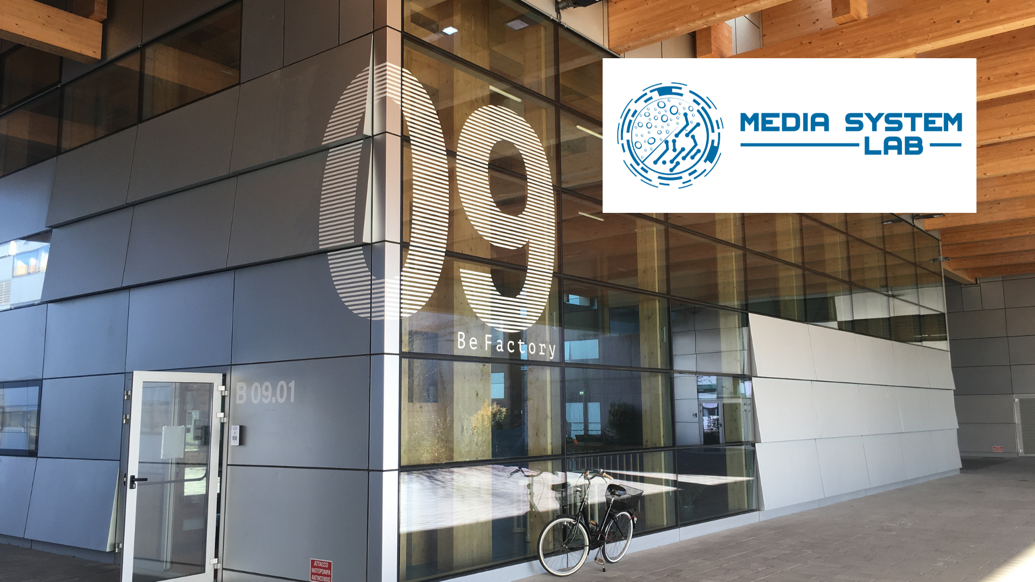
A growing family company
From 3 people in 1998 we plan to become 20 in few months
As a family
Strong point of family business, the management take care of the company like a child and do whatever it takes to make it grows.

Slide 3
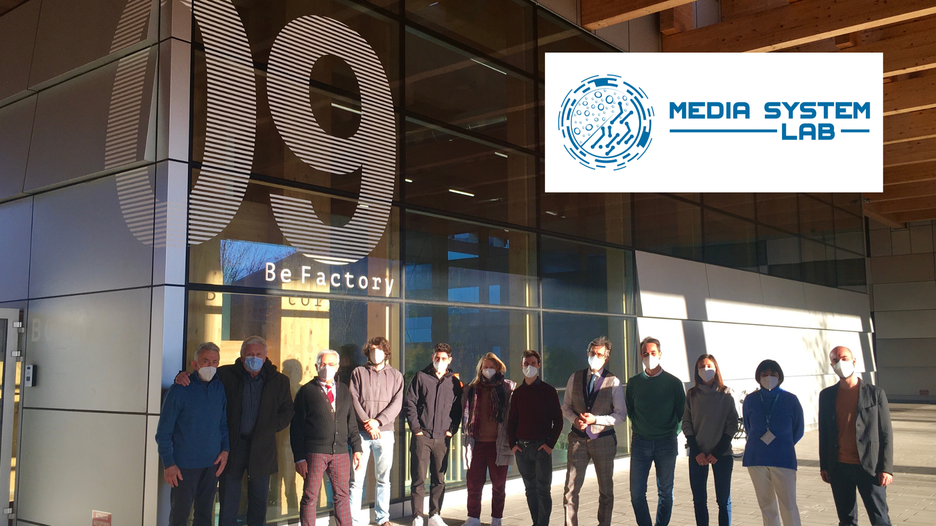
Our people
Good employees are more important than good customers
People
Engagement and retention of the talented ones is a goal. We hire people for attitude and competences.

Slide 4
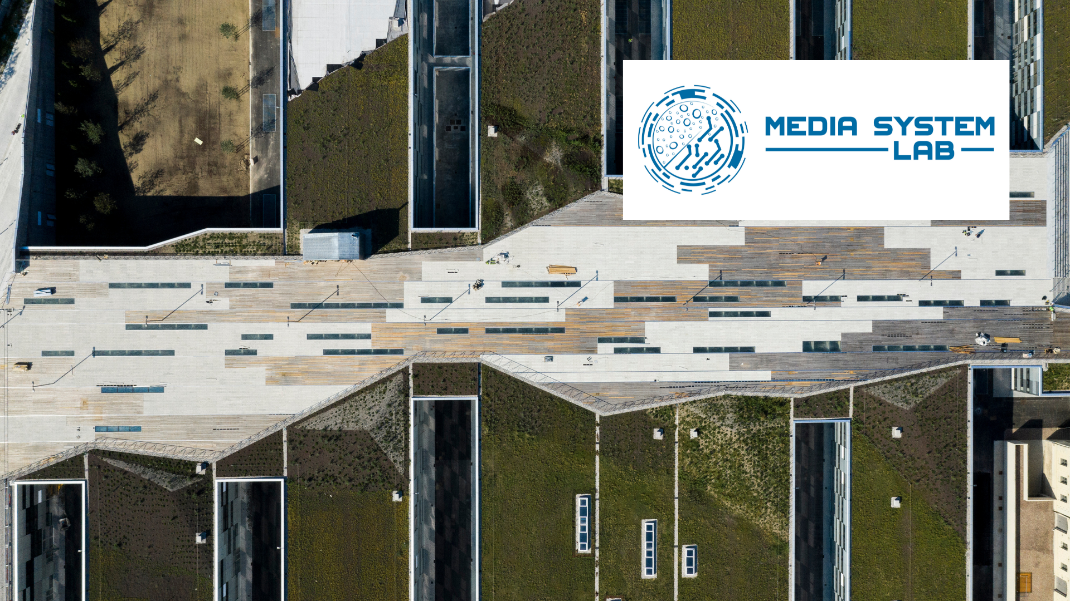
Our common values
Constant improvements
Values
We pursue quality in all our actions, in partners, in products, in support given to customers, we always want to get better and better.

Slide 5
Media System Lab
what we offer
01
Electron microscopy: SEM, TEM, Sample preparation, new and refurbished E.M., service on E.M., Consumables…
The search for quality, in products and in service, is always our distinctive feature.
Quoting Benjamin Franklin:
"The bitterness of poor quality remains long after the sweetness of low prices forgotten".
Media System Lab's attitude is to become a partner of its customers able to solve all their problems in ever shorter times, offering increasingly sustainable and quality solutions, becoming consultants and not just suppliers..
02
MS BIO Lab: the Biotech Pharma portfolio of products and services. Pharma, Biotech, Neuroscience, Oncology, Drug discovery…
03
Site Survey, Magnetic fields cancelling and Anti-Vibration systems, system move…
04
We share our expertise and knowledge: on presence and on-line on our platform MS Academy Lab: webinar and courses

Slide 6
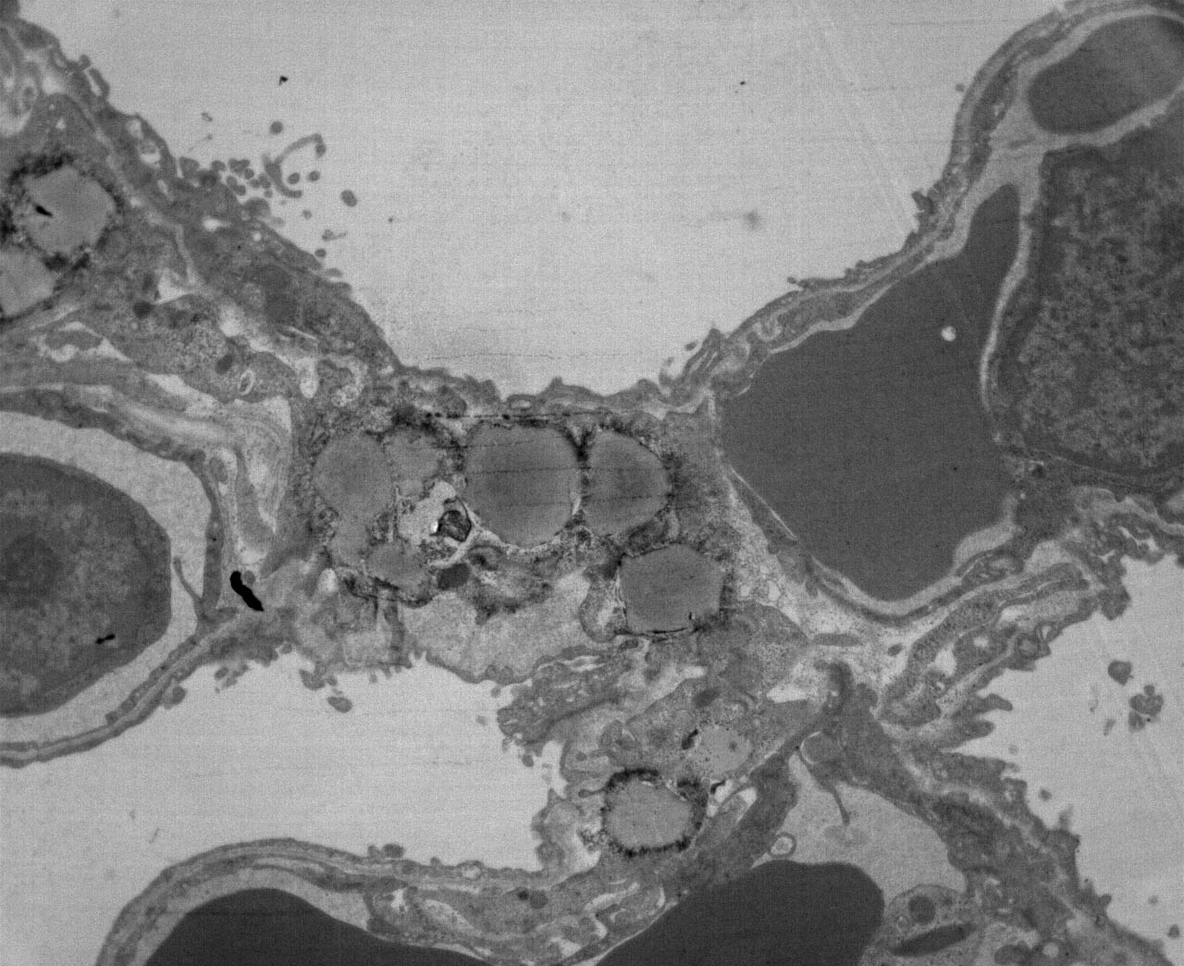
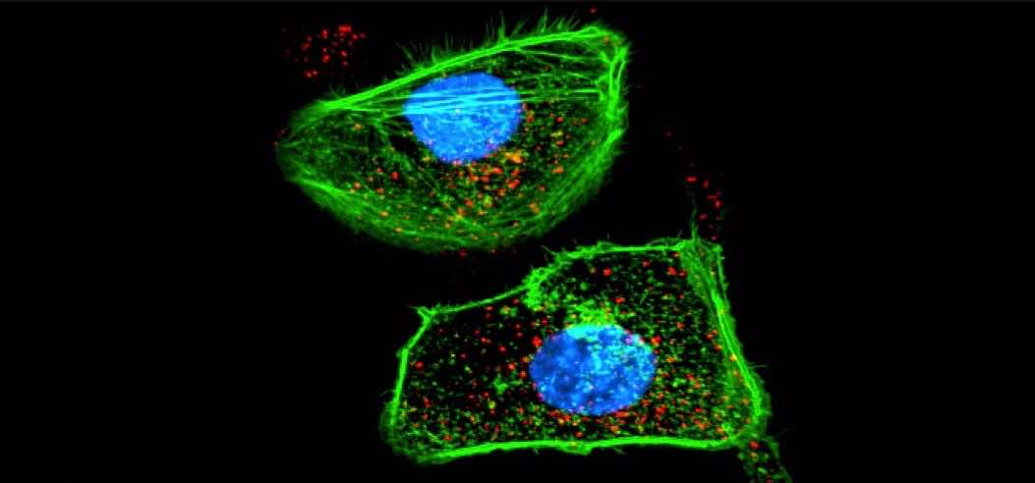
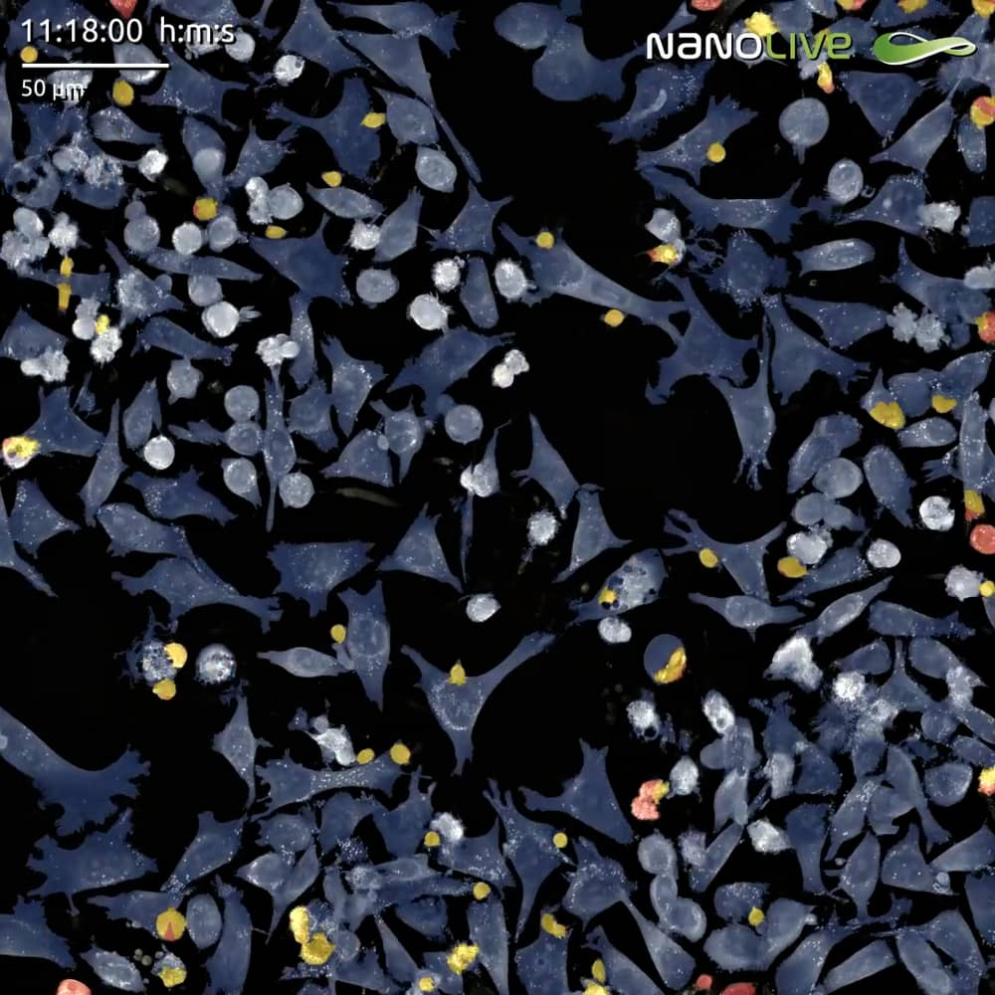
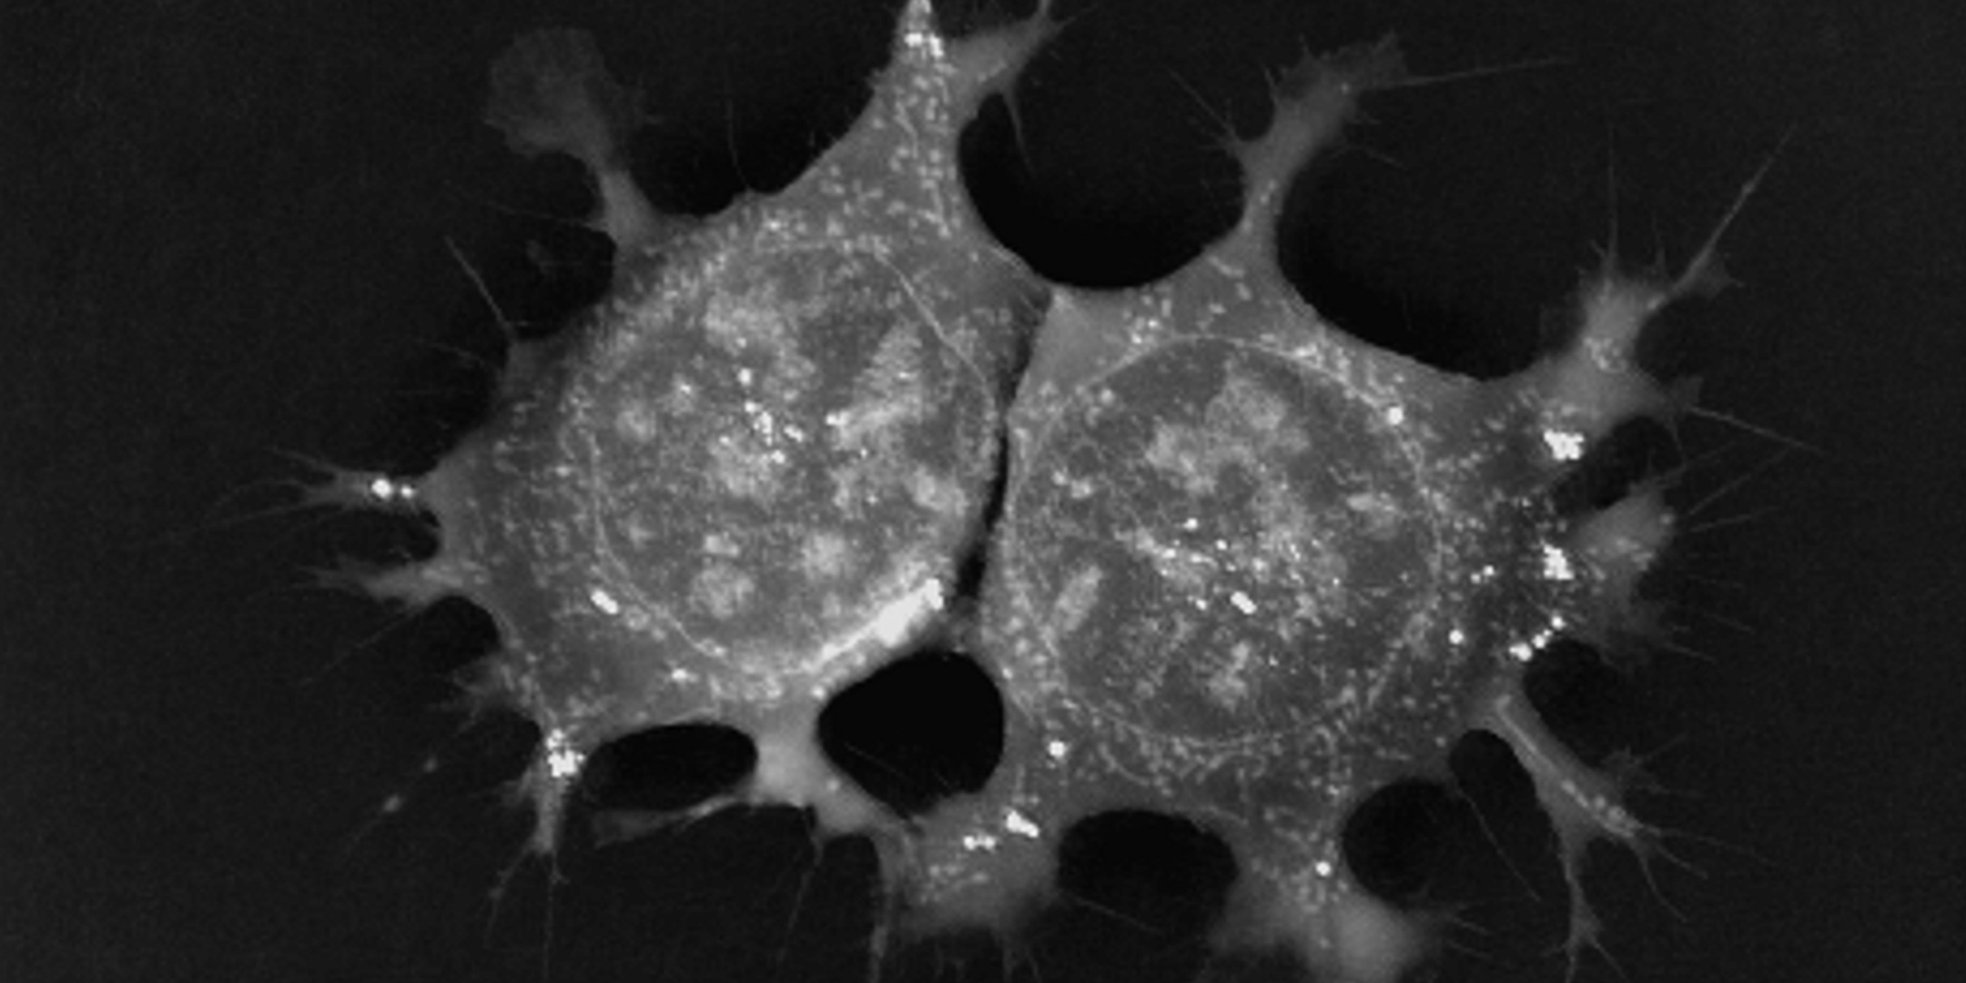
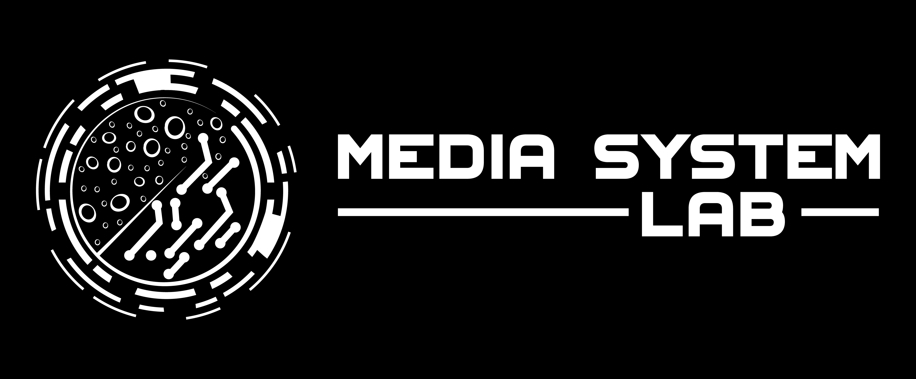
MS BIO Lab our bridge to future of Biotech
Drug Discovery, Biotechnology, Pharma, Neuroscience, Oncology, Live cell imaging, Two photons microscopy, Raman, segmentation, sorting,

Slide 7
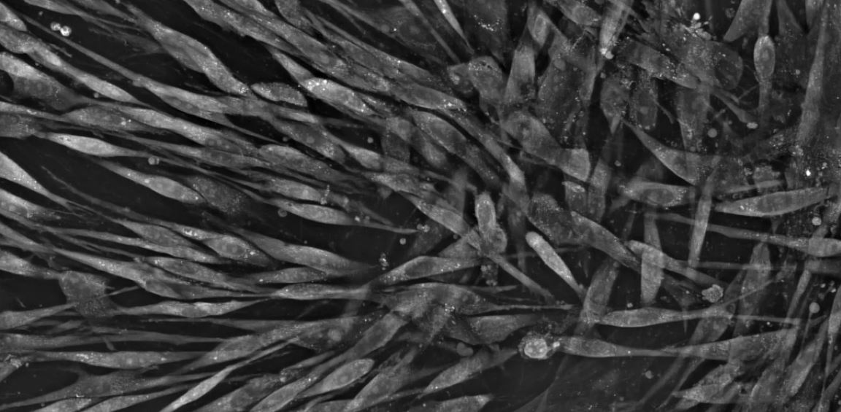
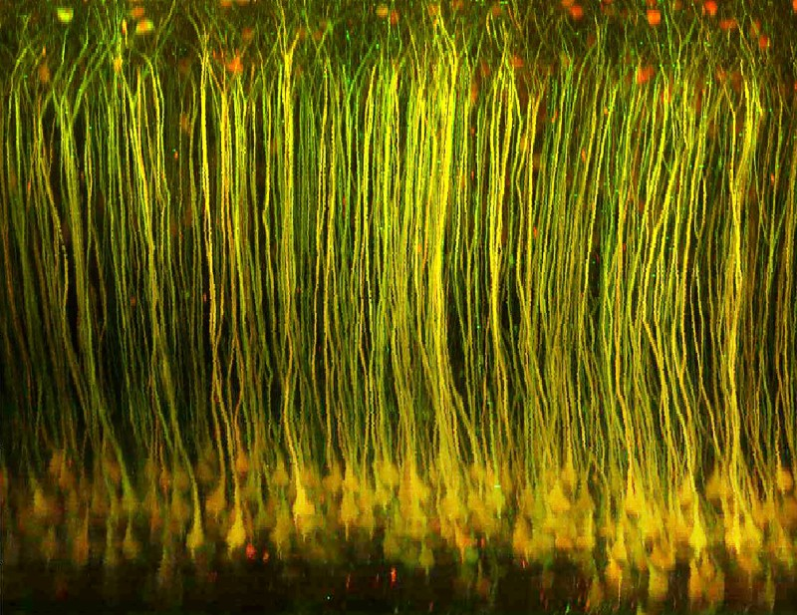
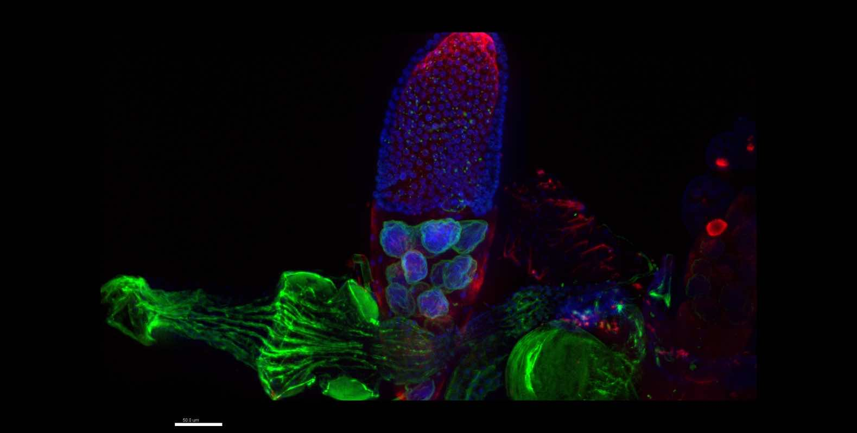
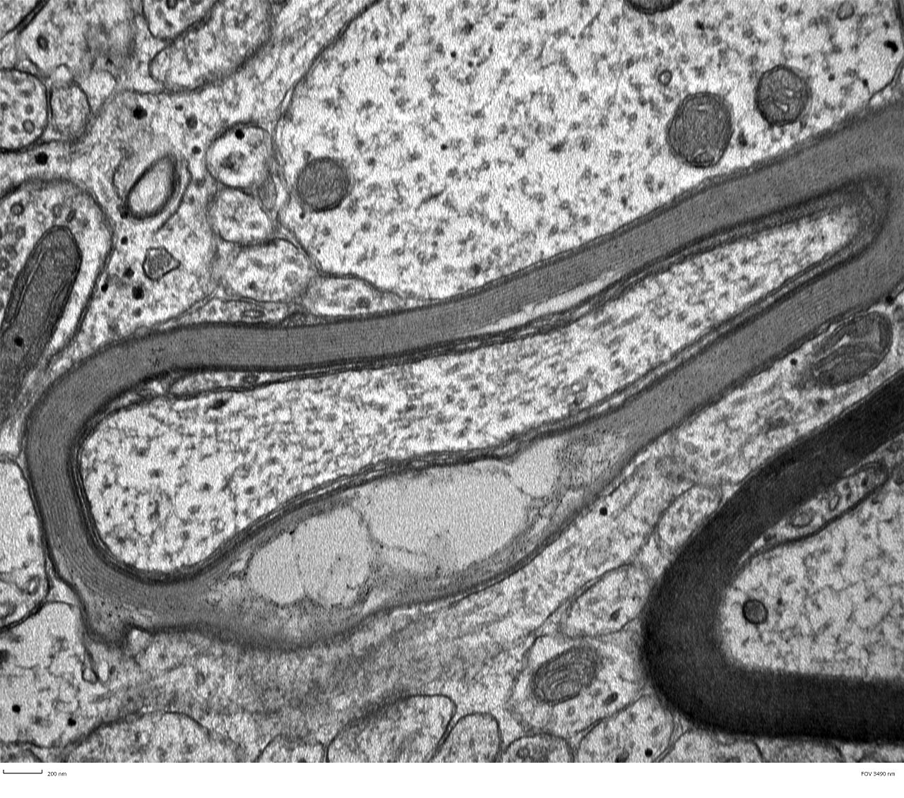
Our Portfolio
The wow effect and the effectiveness of the technology behind
Nanolive
Live-cell imaging, drug discovery, label-free
Femtonics
Two photons, multiphotons Raman
Aurox
Spining disc, Confocal laser-free
Delong
Low Voltage TEM, ED, SEM, STEM

Slide 8
Our fantastic team
The management
Luca Mariani
CEO, CCO
Sales Manager 25y experience
Matteo Mariani
CBDO, CMO
MBA 17y experience
Franco Martegani
COO
CEO Philips, AD Barco 40y experience
Franco Mariani
E.M. Guru
Service Manager Philips/FEI
50y experience

Slide 9
Competences
We enhance diversity and cross-competences
PhD Cell/Cellular and Molecular biology
PhD in Physics
Degree in Molecular biology
Degree in Chemistry, Molecular Science
PhD Chemistry
More…
Degree in Chemistry
MBA, Degree in Physics, Chemistry, Architecture, Mechatronics Electrotechnics…

Slide 10

Competences
We enhance diversity and cross-competences

Slide 11
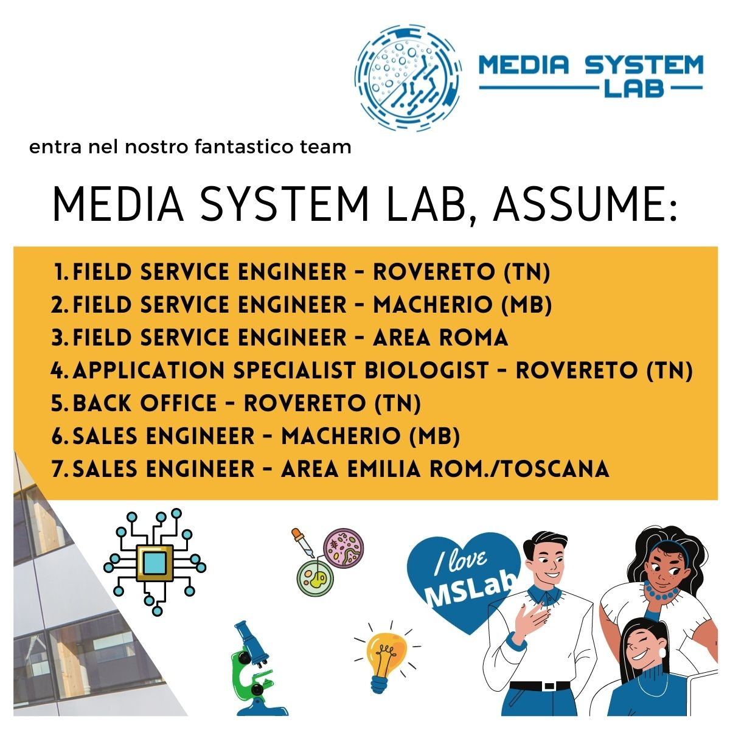
Competences
We enhance diversity and cross-competences

Slide 12
Italy
We have two facilities in Macherio (MB) 30km from Milan and Rovereto (TN) 25km from Trento. We have sales engineers in north west, in center and south, in Sicily and a network of lead generators all around.

Slide 13
THANK YOU
Italy

Slide 14
THANK YOU
INSERT YOUR DECRIPTIONS HERE

Slide 15
LOGO MSLab

Slide 16


Slide 17

Sfondo trasparente

Slide 18
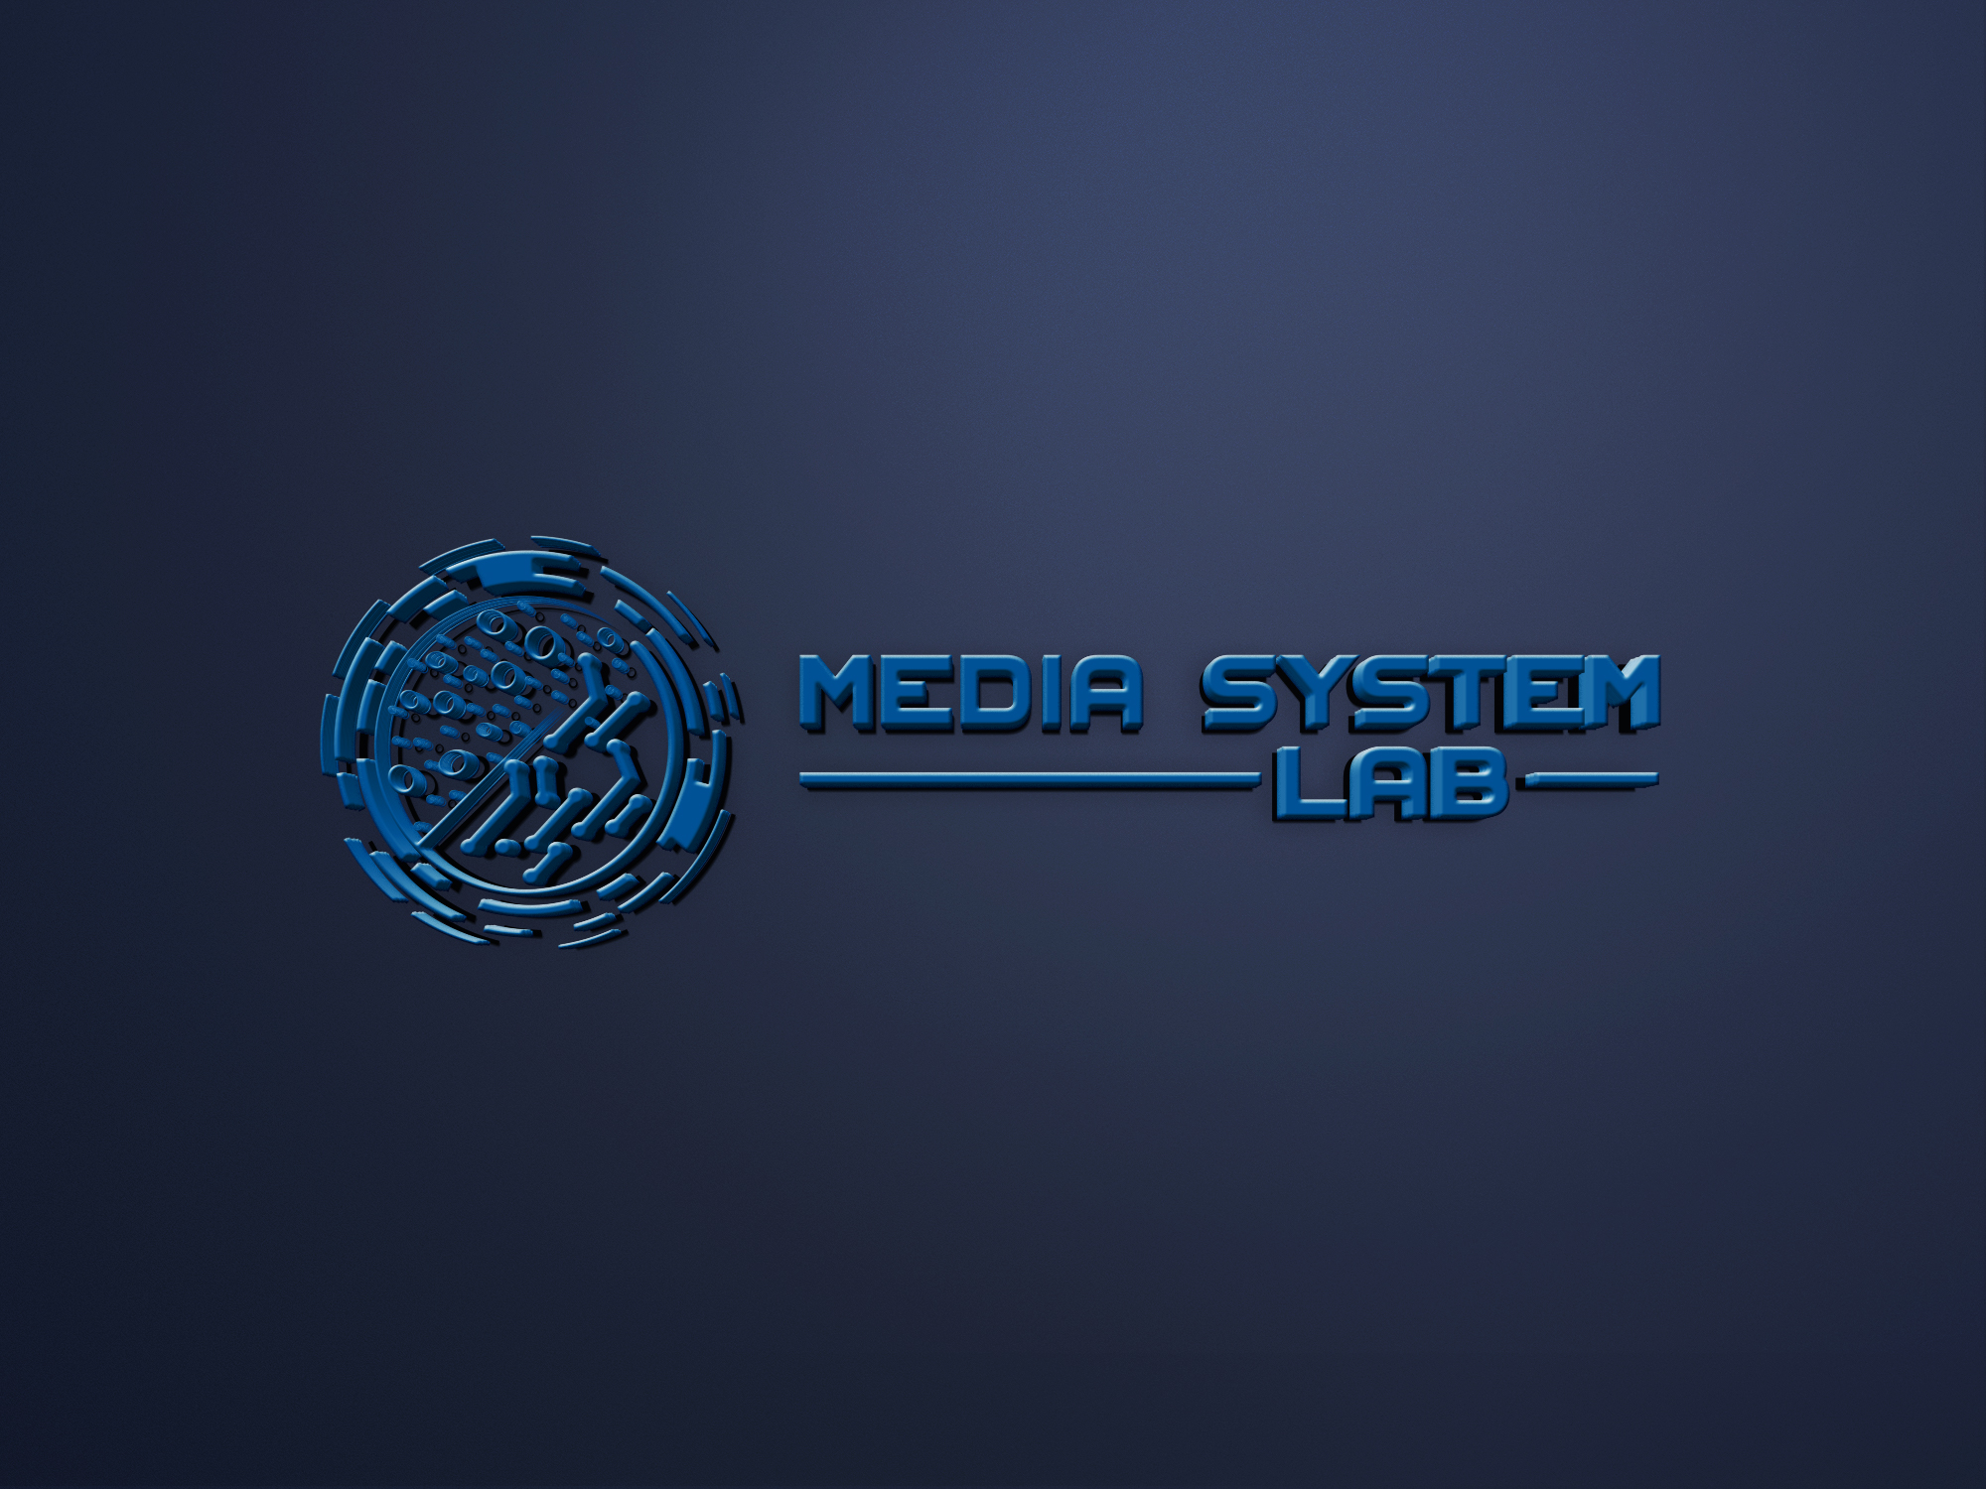


Slide 19





























Slide 20




























Slide 21




























Slide 22

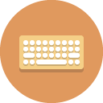


















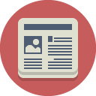








Slide 23
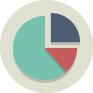











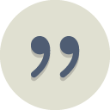
















Slide 24





























Slide 25


























Slide 26

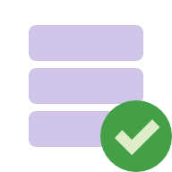




















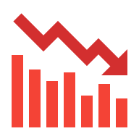














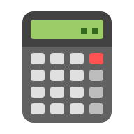










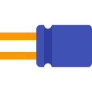
































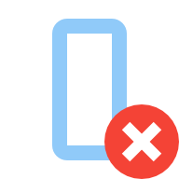








































Slide 27



















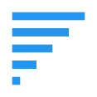




















































































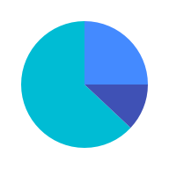













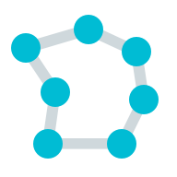


Slide 28





































































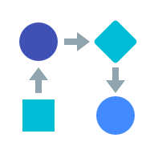

Slide 29
GENERAL ICONS

Slide 35
TECHNOLOGY ICONS

Slide 41
WEATHER ICONS

Slide 44
ECOMMERCE ICONS

Slide 47
FOOD ICONS

Slide 49
OTHER ICONS

